Slide 1
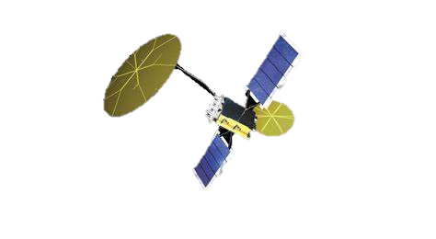


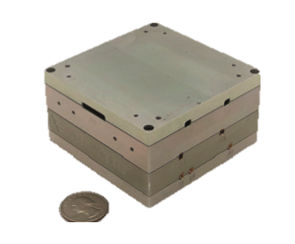
NSR-SDR-MUOS Transceiver
Features:
Full Duplex with integrated diplex filter and antenna switch
Compatible with MUOS Satellite System
Compatible with UHF SATCOM
Space borne, Airborne and Terrestrial Applications
Demonstrated PTN
Specification | Value | Comment
MUOS Tx | Ptx 8 Watts 250-320MHz | Integrated Diplex filter
Waveforms -Tx -Rx | MIL-STD-188-187 MUOS MIL-STD-188-187 MUOS | WCDMA Based Waveform Variable Data Rates
Rx MUOS | 360-380MHz 10Hz stepping across band | Full Duplex Low Phase Noise
 | Global Hypersonic Communications
Services | Beyond Line of Sight Global Coverage IP Centric Communications Direct to War Fighter | Others available
I/O | Ethernet (TCP/IP) | Others available
Telemetry | Temperature(s), Voltages, Current
Encryption | HAIPE TSAB | ITAR
Mechanical | 82x82xmmx48.8mm, 450grams
Environmental | Full Specs -25C to 65C Airborne NASA GEVS 7000
Contact: Sales 760 602-0606x143 2218 Faraday Ave STE 110 Carlsbad, CA 92008

